Slide 1
Competing for Talent: Firms, Managers, and Social Networks
Isaac Hacamo and Kristoph Kleiner (2022)
Presented by Nicholas Thompson

Slide 2
Research question
Do social networks help firms recruit talented managers, particularly high-ability managers, and how do these networks influence recruitment outcomes?

Slide 3
Prior literature
Managers hold significant influence on firm performance (Bertrand & Schoar, 2003; Bennedsen, Pérez-González, & Wolfenzon, 2016; Chang, Dasgupta, & Hilary, 2010; Jenter, Matveyev, & Roth, 2020).
Connections are decisive in CEO hiring as most new CEOs have close connections to the hiring firm (Cziraki & Jenter, 2020).
Labor economics literature (Beaman & Magruder, 2012; Dustmann et al., 2015; Burks et al., 2015; Pallais & Sands, 2016; Brown, Setren, & Topa, 2016; Heath, 2018) shows that firms benefit from the networks of their employees.
Granovetter (1977) emphasizes weak ties in finding employment, while Gee, Jones, and Burke (2017) argue that strong ties have a greater influence on job outcomes.

Slide 4
Hypotheses
Hypothesis 1: Social connections increase the likelihood a given manager joins a given firm.
Hypothesis 2a: The effect of social connections is greater for less-known firms.
Hypothesis 2b: The effect of social connections is greater for tight relationships.
Hypothesis 3: Social connections increase the likelihood a given high-ability manager joins a given firm relative to a low-ability manager.
Hypothesis 4: Managerial social connections affect employment outcomes by influencing the preferences of applicants.

Slide 5
Data
Indiana University MBA Program
Sample includes 2,176 MBA graduates from Indiana University (2003-2013).
Information on cohort and team assignments, GMAT scores, classroom performance, and demographic data.
LinkedIn Employment Records
Individual level employment data from LinkedIn, tracking career paths of graduates over the first five years post-MBA.
Firm-level data, including industry, location, and hiring practices.

Slide 6
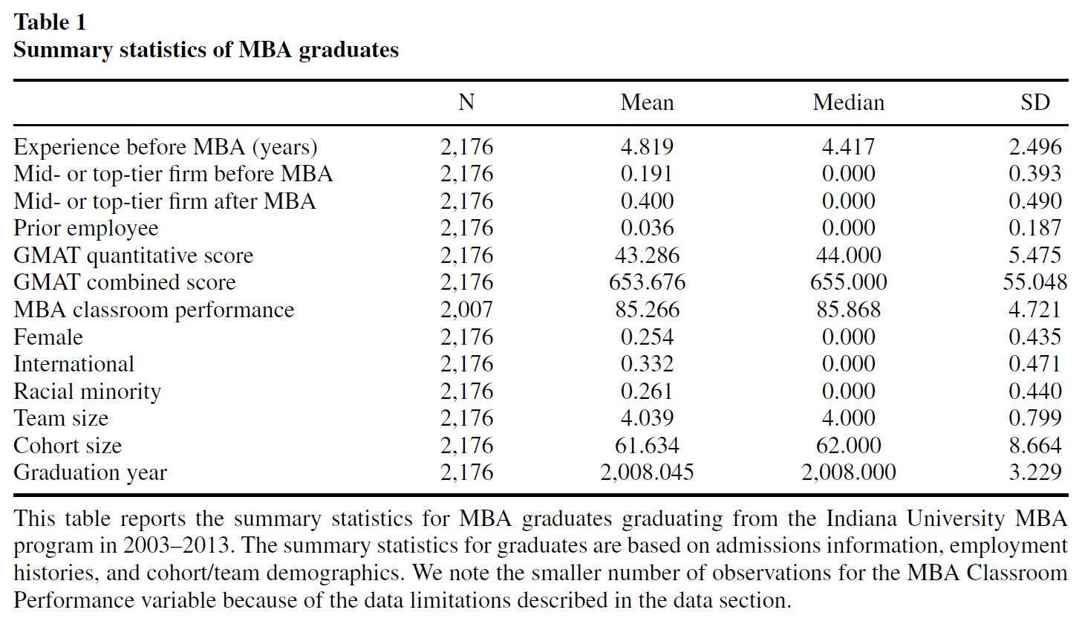

Slide 7
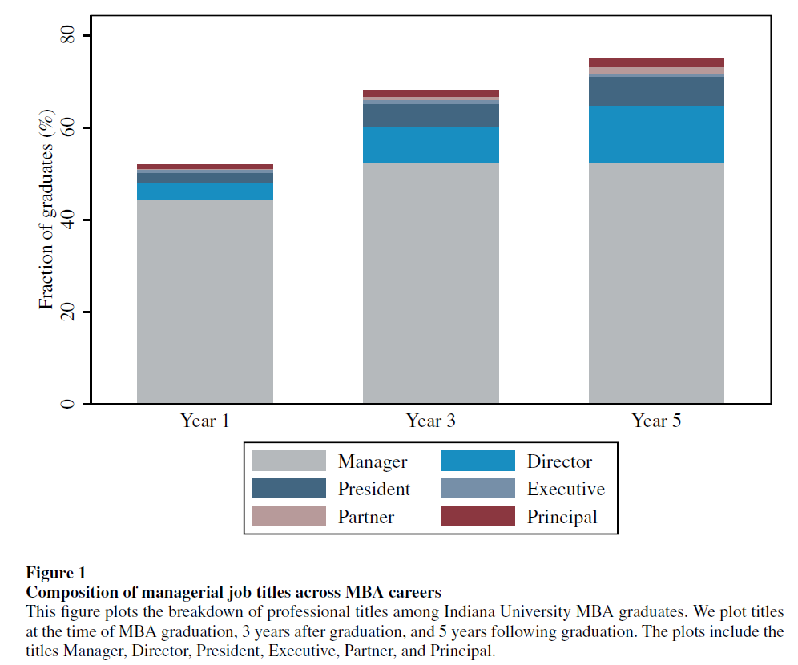

Slide 8
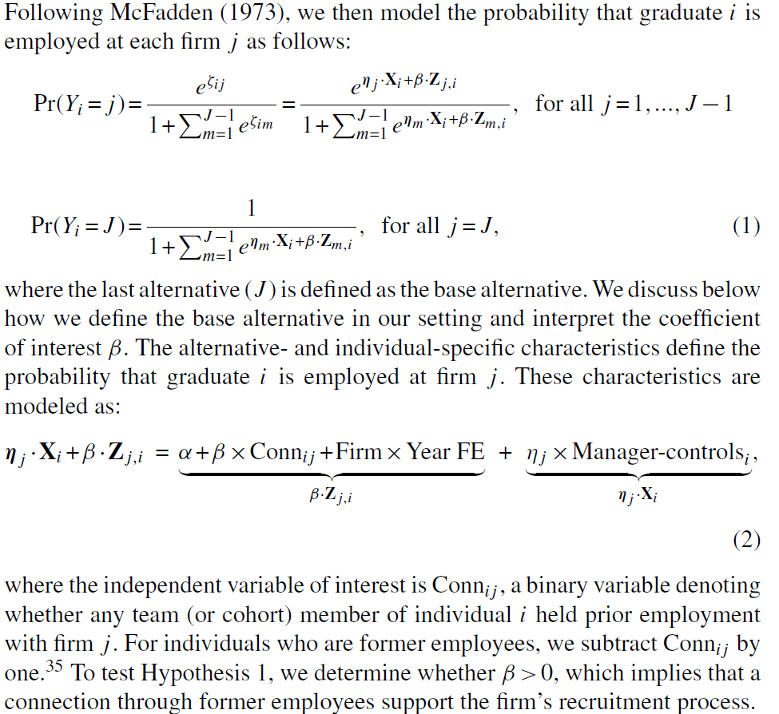
Notes:
In Equation 1, we have a conditional logit model that estimates the probability that graduate i is employed at firm j after graduation. The model captures both individual-specific and firm-specific characteristics that influence the employment decision.
The term βZᵢⱼ represents firm-specific characteristics, such as the number of connections a graduate has to that firm, as well as firm-year fixed effects.
The term ηⱼXᵢ includes individual-specific characteristics of the graduate, such as their gender, nationality, race, GMAT score, and other personal attributes.

Slide 9
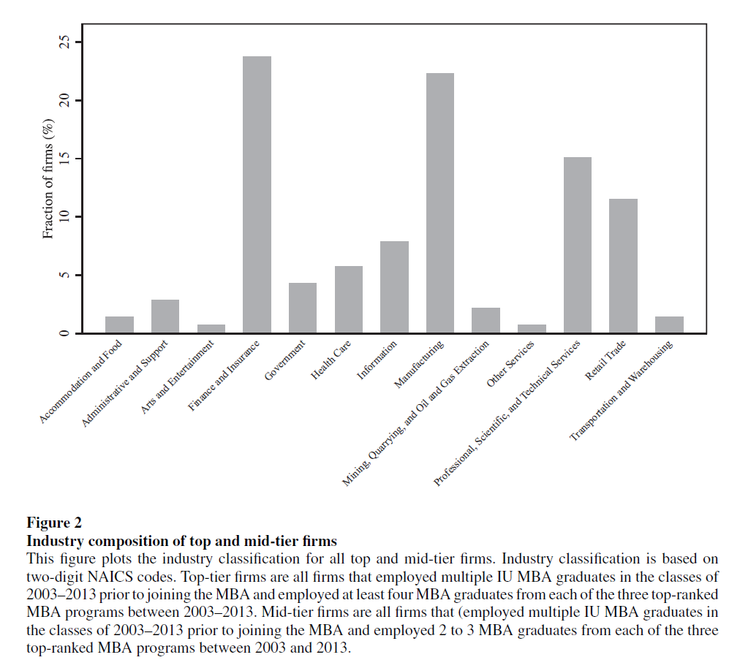

Slide 10
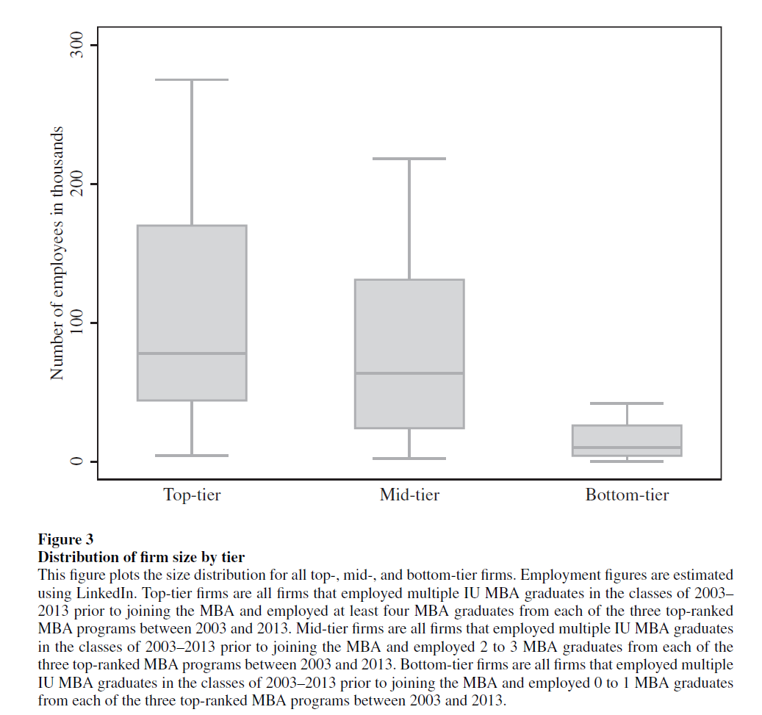
Notes:
Discuss top-tier, mid-tier, and bottom-tier definitions

Slide 11
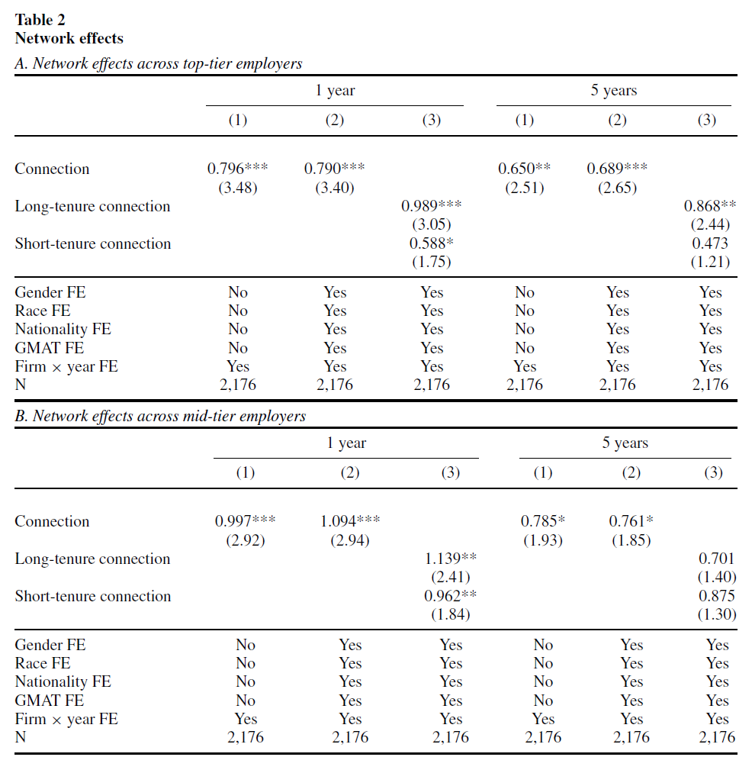
Notes:
Columns 1–2 and 4–5 define the network at the team level and define Connection as a binary variable that takes a value of one when the firm previously employed a student in that team.
Columns 3 and 6 distinguish between whether the prior employee has a short or long-tenure (3 or more years) relationship with the prior employer.

Slide 12
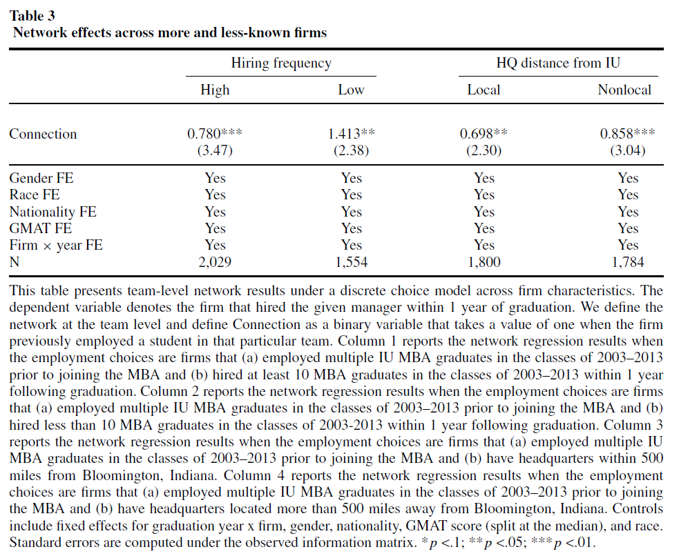

Slide 13
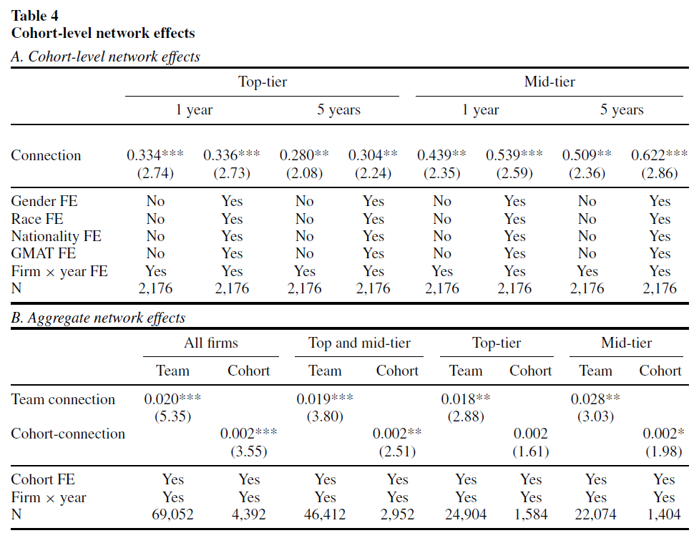
Notes:
Panel A: The effect of a team-level connection is larger than a cohort-level one.
Panel B: Team connection is more important than cohort.

Slide 14
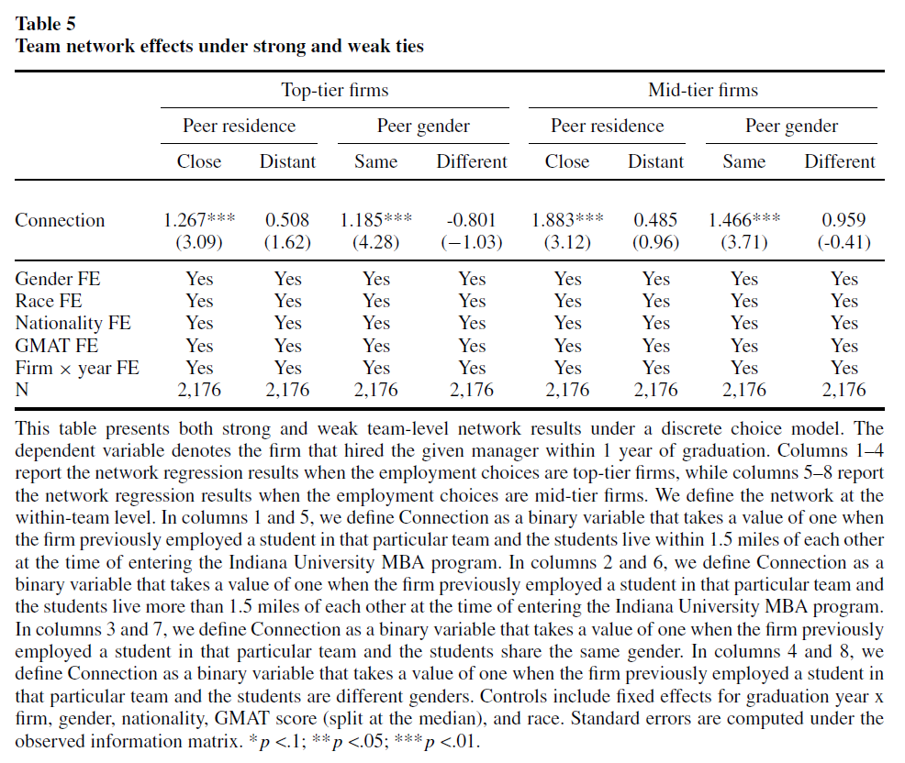

Slide 15
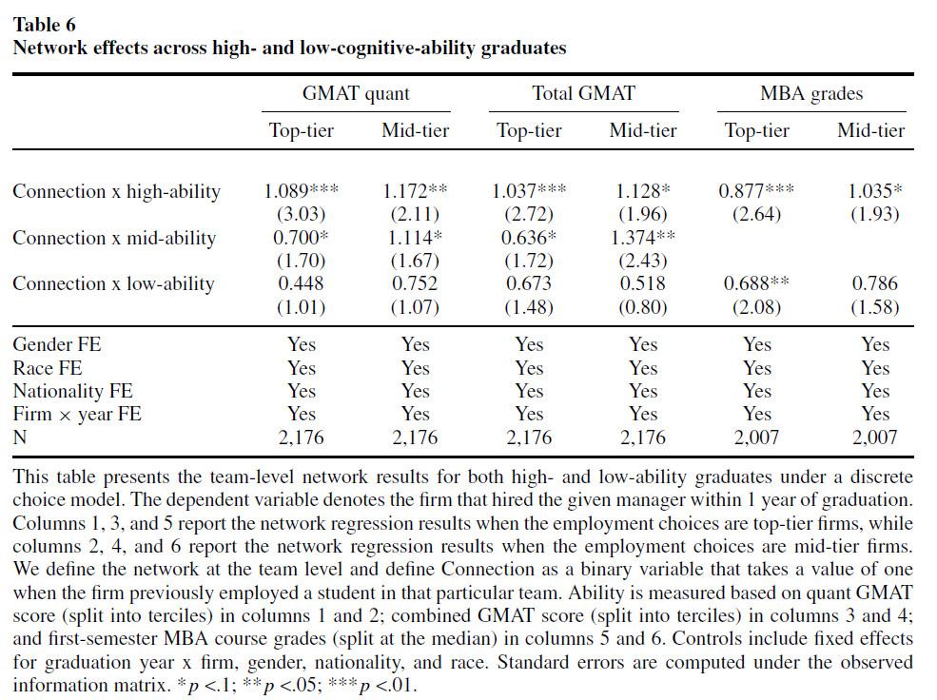
Notes:
Connections matter more for high-ability graduates, likely benefitting the firms.

Slide 16
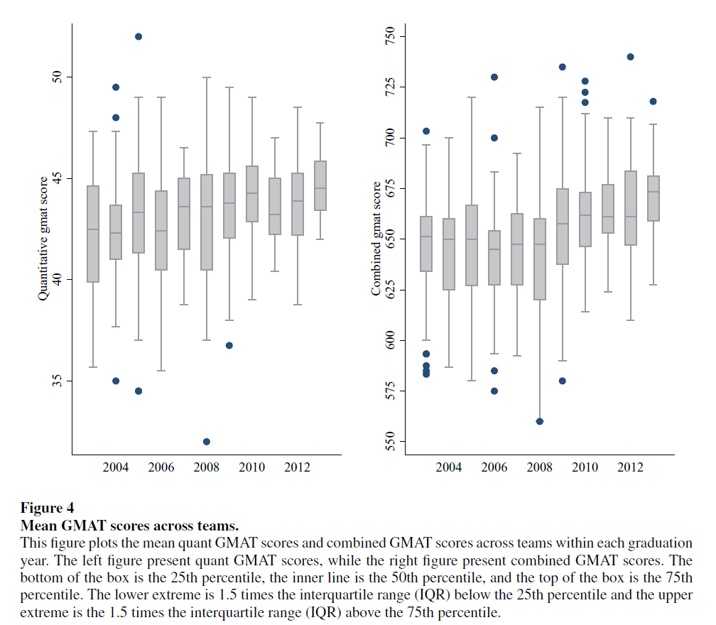
Notes:
Cognitive ability is not equally distributed across teams.

Slide 17
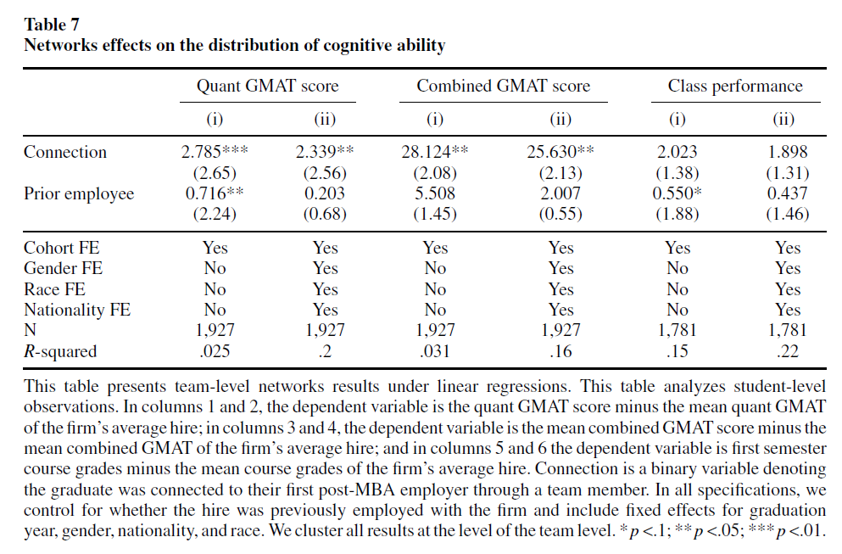
Notes:
Firms tend to hire individuals with higher cognitive ability through social connections.

Slide 18
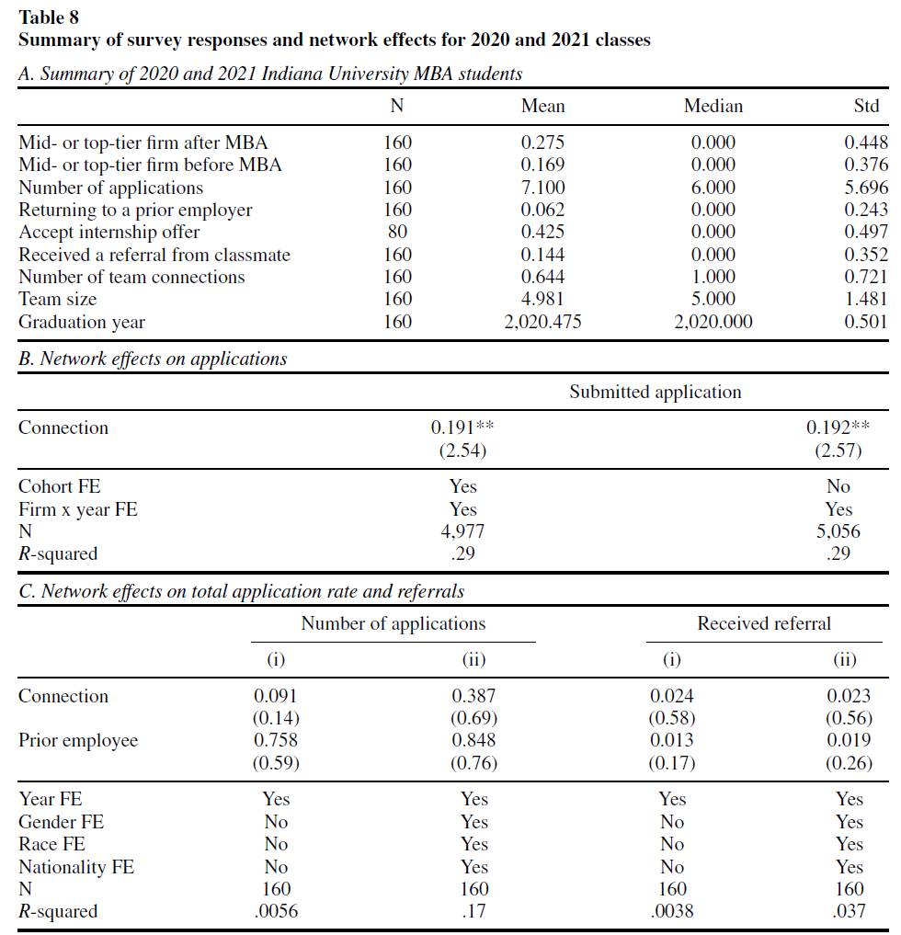

Slide 19
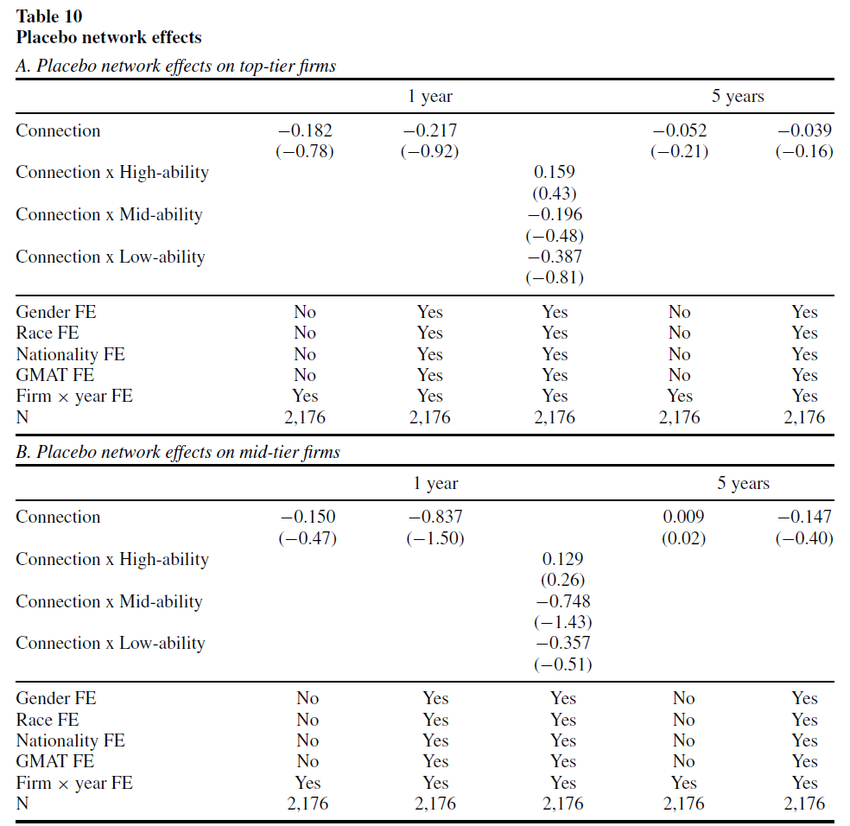
Notes:
To confirm the results are not driven by the team assignment criteria, students are placed into placebo teams that retain the demographics of teams including gender, ethnicity, and nationality.
We find no evidence that placebo team members affect student employment outcomes.

Slide 20
Conclusion
Social Networks Boost Recruitment: Social connections through former employees significantly increase the likelihood of firms hiring high-ability managers, while having little effect on low-ability managers.
Informational Role of Networks: Networks provide information on firm fundamentals, making them an important factor in managerial recruitment, particularly for non-local firms and for those lacking formal recruitment resources.
Importance of Strong Ties: Strong social ties (e.g., team members) have a larger impact than weak ties (e.g., cohort members), with connections living nearby exerting the most influence.
Differentiated Effects for High-Ability Managers: High-ability managers (measured by GMAT scores and academic performance) benefit most from social networks, being more likely to secure positions at top-tier firms.

